Slide 1
Modern Software Architecture
Part 1: Design Guidelines and Software Development Concepts

Slide 2


Meet Your Instructors
Dustin Ewers
Steve Hirscher
Architect: Retirement
12+ years experience
Speaker / Writer
Architect: Consumer
15+ years experience
5+ years at CUNA

Slide 3
Where does today’s course fit in?
Foundation for Azure Fundamentals
Modern Patterns Level-set
Cloud Readiness
Notes:
This course provides the basis for the future Azure course
This is all about stuff you can do today to get ready for the cloud

Slide 4
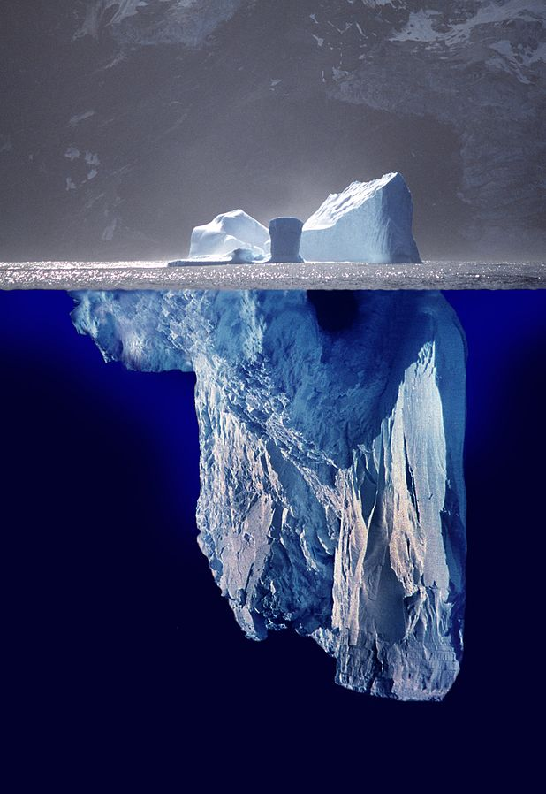
Goals
Learn Modern Patterns
Apply These Patterns Pragmatically
Evolve Legacy Applications
Notes:
Image Credit: https://commons.wikimedia.org/wiki/File:Iceberg.jpg
Learn Modern Patterns
Apply These Patterns Pragmatically - when to use and when not to use
Evolve Legacy Applications - you don’t always get a green field application
----
There’s a lot of data here.
You can dig deep into any of these topics, so don’t consider this as the be all end all.

Slide 5
Logistics
Breaks
Discussion
Parking Lot
Breaks
Discussion
Parking Lot
Notes:
Breaks - We’ll have a few, so don’t worry about being stuck to your chair
Discussion - Encouraged, we’ll have several activities and discussions throughout the course
Parking Lot - If we get into a rabbit hole or we need to move on, we’ll have a parking lot of topics we can revisit at the end of the class.

Slide 6
Preview
Design Goals
API Design
Antipatterns
Testable Software
Architecture Patterns
Monoliths
Microservices
Event-Driven Architecture
Evolutionary Architecture

Slide 7
Architectural Goals

Slide 8
Pillars of Software Quality
Scalability
Availability
Resiliency
Management
Security
Notes:
These are the goals of any software architecture
https://docs.microsoft.com/en-us/azure/architecture/guide/pillars

Slide 9

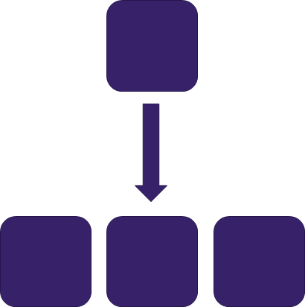
Scalability
Scaling Up
Scaling Out
Notes:
Ability of a system to handle load
Scaling:
Scaling Up (bigger machines) vs. Scaling Out (More machines)
Needs to be keyed to the target audience of an application.
Keys to success:
Avoid dependence on individual machines
Prefer stateless servers

Slide 10
Availability Resilience Reliability
Mean time between failures (“9’s”)
Health Monitoring
Failure Mode Analysis
Notes:
Proportion of time a system is up and working.
Availability, Resilience, Reliability, all are similar, but worth thinking about.
Measured in “9’s” as 99.999% - five nines is a good target
Each additional “nine” increases the price of the application
“9’s” aren’t the be all end all. lots of small components can fail separately
Ability to recover from failures
Ideally systems can easily and automatically recover from failures
Especially true in cloud applications because you have lots of moving parts running on top of commodity hardware.
Failure Mode Analysis
What kinds of failures is the system going to have? How can you recover from each failure?

Slide 11
Management
Automation
Telemetry
Analysis
Notes:
Ease of managing the overall health of the system.
Keys:
Automate everything you can
Gathering telemetry data from the application to use for reports
Instrumentation. Generating the raw data, from application logs, web server logs, diagnostics built into the Azure platform, and other sources.
Collection and storage. Consolidating the data into one place.
Analysis and diagnosis. To troubleshoot issues and see the overall health.
Visualization and alerts. Using telemetry data to spot trends or alert the operations team.

Slide 12
Security
Identity Management
Infrastructure
Application Security
Data Storage
Notes:
TODO - Deepen this section or mention we’re not digging into specifically.
Identity Management
Infrastructure
Application Security
Data Storage

Slide 13

12 Factor App - Origins
Notes:
Origins: Heroku
By Heroku to sell more Heroku

Slide 14
12 Factor Apps
Codebase
Dependencies
Config
Backing Services
Build, Release, Run
Processes
Port Binding
Concurrency
Disposability
Dev/Prod Parity
Logs
Admin Processes
Notes:
Factors to make apps more cloud compatible
Decoupling hosting related dependencies
** Most applications do this stuff by default.
https://12factor.net/
http://www.clearlytech.com/2014/01/04/12-factor-apps-plain-english/

Slide 15
12 Factors: Source and Environments
Source control
Build and release processes
Store configuration in the environment
Environments should be similar
Notes:
Keep your code in source control - git
Have a separate build process - Azure Dev Ops
Separate processes for builds, releases and deploys
Pipelines in Azure Dev Ops | CI and CD are separate functions
Configuration data (what changes between environments) goes into an environmental config
Environments Should be Similar
obviously we can’t make things identical, but they should be as close as possible

Slide 16
12 Factors: External Dependencies
Abstract Infrastructure Dependencies
Use URLs for Services
Stateless Services
Notes:
Dependencies
Abstract them out
Make them explicit in config files
Design so they can be swapped out as needed
You might want to change them down the road
Backing Services
Make them accessible by URLs, even when they’re on the same machine
Keep backing service implementation details out of your code
Statelessness
Applications should be composed of stateless processes
avoid using local session state or similar constructs
These services should be somewhat disposable
Farm Animals, not Pets

Slide 17
API Design

Slide 18
Steve Yegge’s Platform Rant
Notes:
Context...
Steve Yegge was a guy who worked for Amazon and Google and was contrasting the approaches the two companies take.
He found that Amazon did one thing much better than Google, Platforms

Slide 19
Amazon’s Key to Success
All teams will henceforth expose their data and functionality through service interfaces.
Teams must communicate with each other through these interfaces.
There will be no other form of interprocess communication allowed: no direct linking, no direct reads of another team's data store, no shared-memory model, no back-doors whatsoever. The only communication allowed is via service interface calls over the network.
Notes:
Steve Yegge’s Platform Rant
https://gist.github.com/chitchcock/1281611
The upshot of this is that Amazon became powerful because they built an API first culture.
this approach, in addition to making you a more disciplined company, enables platforms
Even if it’s internal software, this encourages
Encourages Accessibility

Slide 20
Steve Yegges Platform Rant - cont...
It doesn't matter what technology they use. HTTP, Corba, Pubsub, custom protocols -- doesn't matter. Bezos doesn't care.
All service interfaces, without exception, must be designed from the ground up to be externalizable. That is to say, the team must plan and design to be able to expose the interface to developers in the outside world. No exceptions.
Anyone who doesn't do this will be fired.
Notes:
Steve Yegge’s Platform Rant
https://gist.github.com/chitchcock/1281611
The upshot of this is that Amazon became powerful because they built an API first culture.
this approach, in addition to making you a more disciplined company, enables platforms
Even if it’s internal software, this encourages
Encourages Accessibility

Slide 21
API Advantages
Enables Platforms
Encourages Accessibility
Reduces Tight Coupling
Notes:
Enables Platforms
APIs allow you to create platforms, while you’re not going to become the next Amazon, you can build on what you already have.
Encourages Accessibility
Makes data easier to consume by other people, can be reused by different types of applications down stream.
Reduces Tight Coupling Maintaining different services allows for teams to work on individual services instead of a giant monolith.
Bezos was famous for “two pizza” teams

Slide 22
API Patterns

Slide 23
HTTP Protocols
SOAP
REST
GraphQL
Notes:
Most of the API communication methods we care about are built on HTTP.
SOAP
XML based format, we aren’t going to talk about it in this presentation
Use REST instead
REST
The current default for building modern APIs
This should be your default too
GraphQL
A new standard that’s currently emerging that you should know about
Useful in certain situations

Slide 24
REST
Representational State Transfer
URL Format: <url>/<resource>/<parameters>
Example: https://your-site.com/policies/543534
Notes:
Representational State Transfer
a fancy way of saying that APIs should represent resources exposed through URLs
an architectural pattern for APIs
HTTP was originally meant to work this way
Actually uses HTTP Verbs for what they were meant to be used for

Slide 25
HTTP Verbs
Verb | Purpose
GET | Read data
POST | Create Data
PUT | Update Data
DELETE | Delete Data
Notes:
Makes use of HTTP Verbs to access those resources using a consistent interface

Slide 26
Side Effects
GET, PUT, and DELETE should be idempotent
POST should be free of unrelated side effects
Use the Correct HTTP Response Status Codes
Notes:
GET, PUT, and DELETE should be idempotent
idempotent is a fancy word that means you can do it over and over again and get the same result
More Info:
https://docs.microsoft.com/en-us/azure/architecture/best-practices/api-implementation

Slide 27
How to Make a Good REST API
Don’t Database over REST
Cater to Customers
Don’t Overshare
Notes:
Database over REST
- don’t do it. This is easy, but it’s sloppy.
Cater APIs to Customer Needs - we make things for customers, even internal customers
Don’t overshare
it’s easy to create a data breach by exposing too much data or engaging in anti patterns like sequential ids
Share only what you need to power customers needs
less of a concern with internal APIs, but worth thinking about

Slide 28
Versioning APIs
No Versioning
URI (eg. https://your-site.com/v1/policies/543534)
Query String (eg. https://your-site.com/policies/543534?version=1)
Header Versioning
Notes:
No Versioning
Major changes go in new URLs
Microsoft often uses Query String, which is probably the easiest because you can default it
None of these are perfect approaches.

Slide 29
Documentation
Open API (aka Swagger)
Integrate with .NET using Swashbuckle
Notes:
The easier way to do service discovery is to just create documentation.

Slide 30
GraphQL
Made by Facebook
Optimized for mobile usage
Client Determines Output via Queries
Notes:
GraphQL is the newest API hot sauce.
It’s an alternative to REST.
Instead of getting resources from a database, you expose a graph endpoint and query it for the data points you need.
It reduces the number of requests you need to pull data in
It also reduces the size of those requests because you’re only pulling back what you need

Slide 31
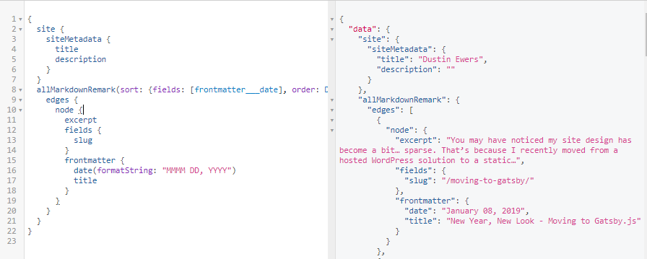
GraphQL Example
Notes:
This is from a Gatsby.js website, which uses GraphQL to generate site data.
You can query anything in the whole schema from Graph.

Slide 32
GraphQL Disadvantages
Relational Databases
Customer Understanding
Lack of Documentation
Sketchy .NET Support
Notes:
Querying Relational Databases
you can easily tank performance by trying to query a relational data store.
Not a ton of .NET support
Customer Understanding
GraphQL is the “csv of the API world”
You aren’t learning anything about your customers.

Slide 33
YAGNI
You Aren’t Going to Need It
Notes:
You don’t have to everything up front.
You don’t have to do everything period.
People try to frontload all of their concerns into the beginning of their application development. That’s not how it works in agile development.
Lots of people try to make something that’s good for everything. Architecture is all about tradeoffs
Lengthy “sprint 0”
Focus on current needs

Slide 34
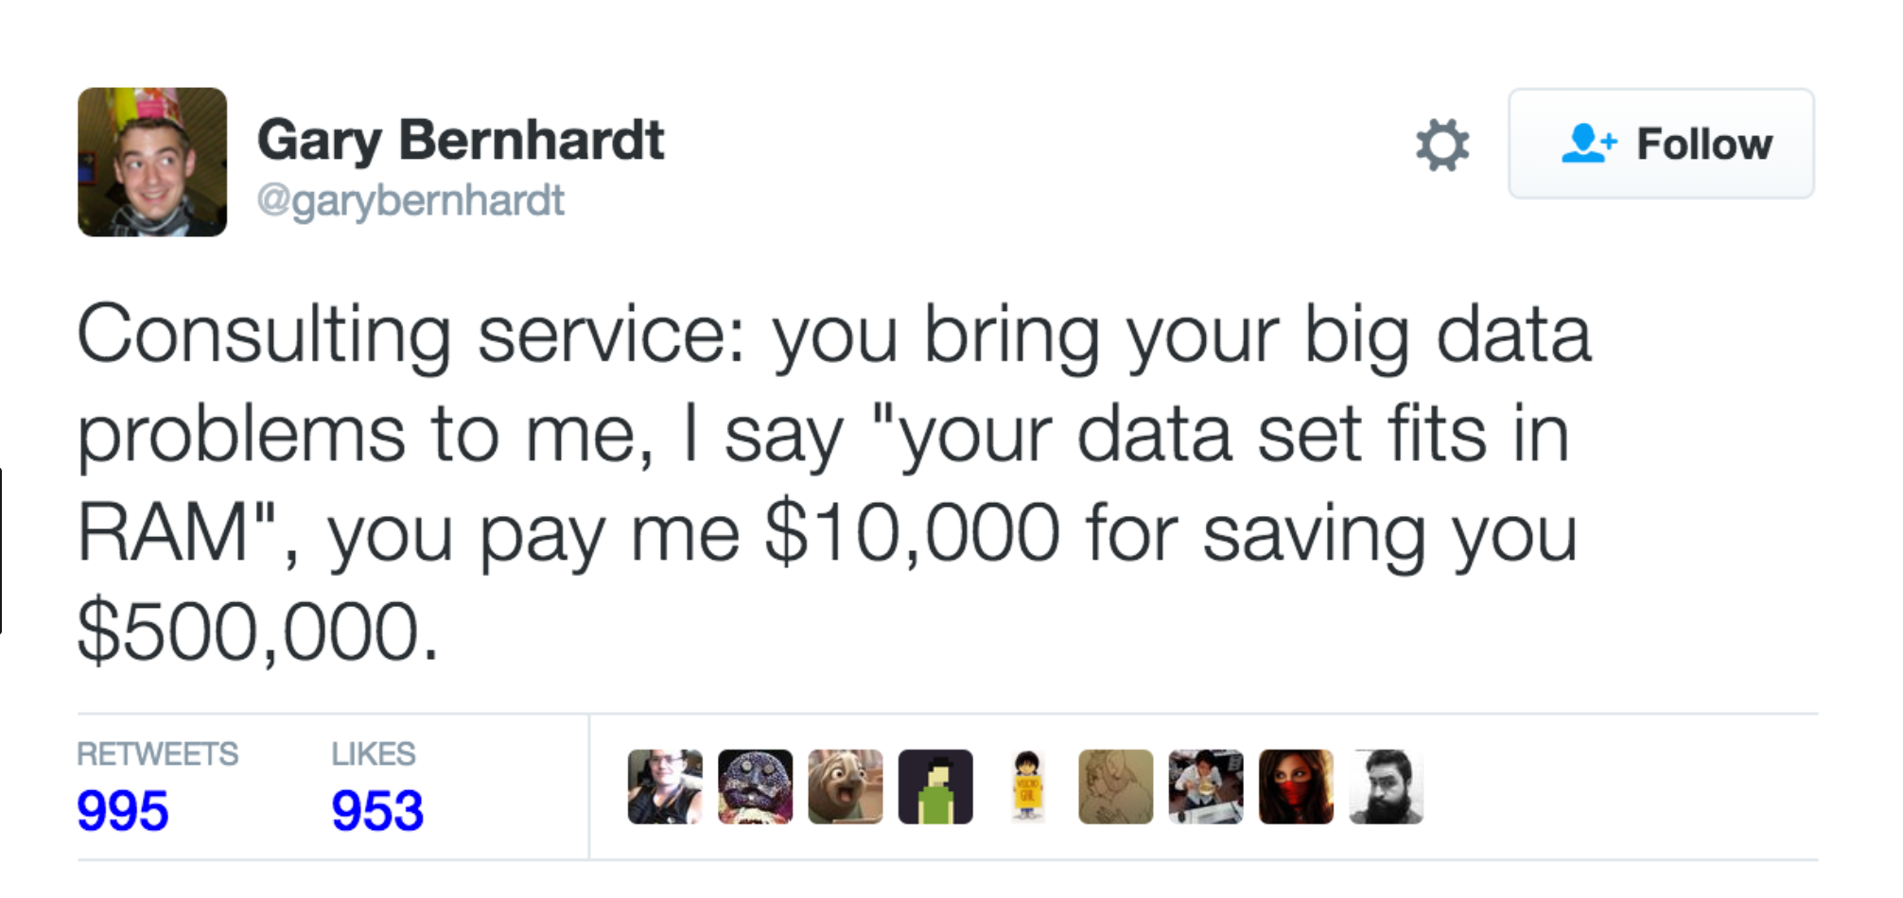
Big Data
Notes:
Most people don’t need big data

Slide 35
Big Data
Volume
Velocity
Variety
Veracity
Validity
Notes:
What big data can be?
Any of the following V’s:
Volume - lots of data Velocity - lots of data throughput - streaming Variety - lots of different kinds of data Veracity - sketchy sources of data Validity - figuring out what’s true and not true

Slide 36
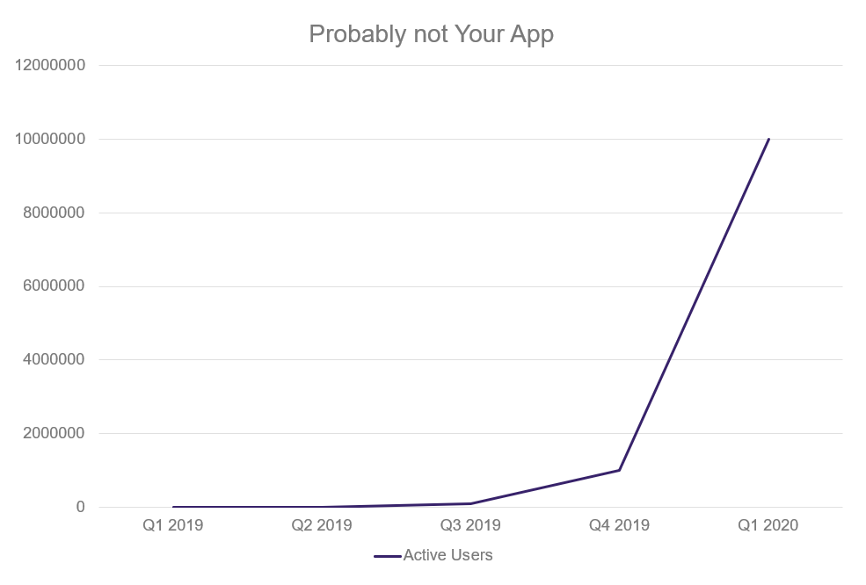
Infinite Scalability
Notes:
Most apps don’t have exponential user expansion
You usually have a decent idea of how many people are going to be using your app at one time
Most people aren’t Facebook

Slide 37
Problem Envy
You are not Google You are not Amazon You are not Facebook You are not Spotify
… and that’s OK.
Notes:
Problem Envy:
You are not Google
You are not Amazon
You are not Facebook
You are not Spotify
-- It’s not that those companies have nothing to offer you, but don’t go building everything for infini-scale.

Slide 38
Most people don’t need infinite scale
Stack Overflow
4 Microsoft SQL Servers 11 IIS Web Servers 2 Redis Servers 3 Tag Engine servers 3 Elasticsearch servers
500 million SQL queries
200 million HTTP Requests
5.8 billion REDIS hits
Notes:
Even Stack Overflow only uses a few servers:
https://nickcraver.com/blog/2016/02/17/stack-overflow-the-architecture-2016-edition/
https://www.slideshare.net/AmazonWebServices/scaling-up-to-your-first-10-million-users-83356325

Slide 39
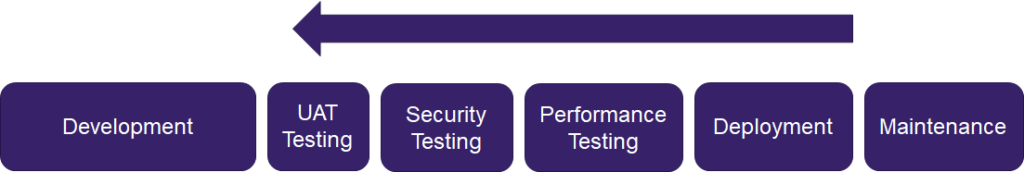
Shifting Left
Notes:
Question: How many people have ended up in a crash cycle of performance improvement or security remediation at the end of a project?
Move practices like security and performance earlier in the dev cycle.
Automate them as much as possible.
Instead of doing big band tests at the end, which generally lead to big bang death marches
It’s all about balance

Slide 40
How to Shift Left
Non-functional Requirements
Definition of Done
Automate Everything
Notes:
Non-functional Requirements - include requirements for performance and security
Definition of Done - bake those requirements into your definition of done
ie. “it’s not done until it has some test coverage”
ie. “It’s not done unless it returns a response in less than a second.”
Automate Everything Testing
Security
Deployment

Slide 41
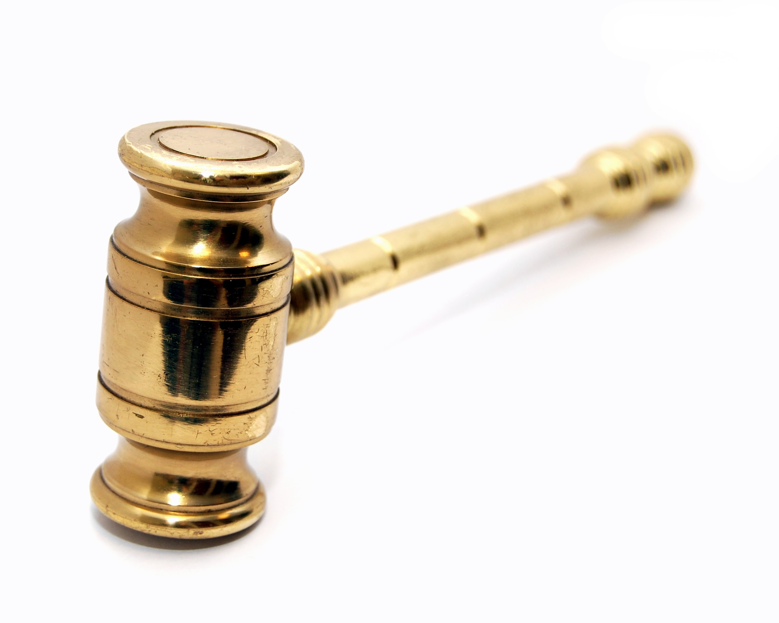
Golden Hammer
Notes:
People tend to get attached to frameworks or concepts and think they’re the answer to everything.
Discussion: Anyone want to throw out some examples?
Examples:
GraphQL
Microservices
Blockchain
AI
Source:
https://www.flickr.com/photos/walkn/3314689121

Slide 42
The Purpose of Software is To Deliver Business Value, Not Pad Your Resume
Notes:
The Goal: To know when to use these things and when not to.

Slide 43
Changeable Architectures
Building software you can change and test.

Slide 44
Problems...
Users Change
Patterns Change
Technologies Change
_________ Changes…
Notes:
So we learned about all these nifty patterns, but we don’t have software like that…
Stuff changes…
how do we write software that’s resilient to changes

Slide 45
What’s the most important concern for changeable software?
Notes:
Answer: Testing

Slide 46
Tests Equal Safety
Notes:
Number One Concern for changing software.
Automated tests create safety. They allow us to change the application.
At their highest level, you can deploy changes straight from source control without having to run through a department of manual testers
Enables maximum velocity.

Slide 47
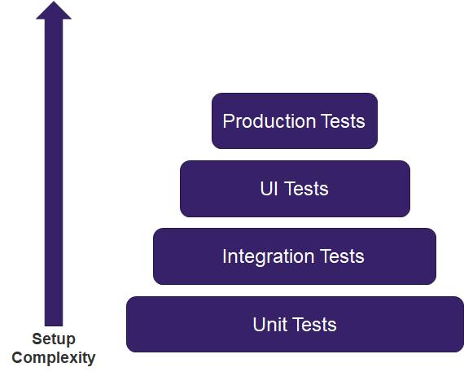
Automated Test Pyramid
Notes:
The harder to maintain tests should be fewer than the easy ones.

Slide 48
How do we build testable software?
Notes:
The first step is to build software we can test.
Tests reduce the cost of change.
How do we do that?
Isolate dependencies

Slide 49
Isolate Dependencies
Databases
Session Handling
Caching
Filesystems
UI Layers
Frameworks
External Services
Notes:
by isolating dependencies,
Here are some things to isolate…

Slide 50
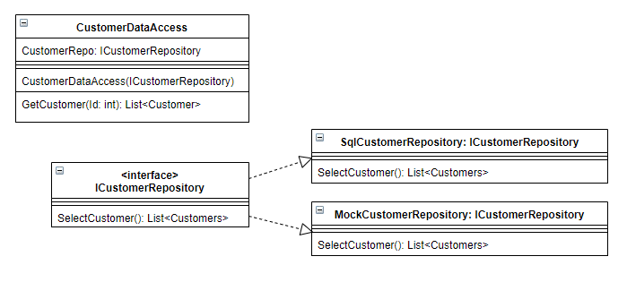
Isolation Patterns
Dependency Injection / Inversion of Control
Notes:
Isolate Dependencies
helps with the 12 factor concept

Slide 51
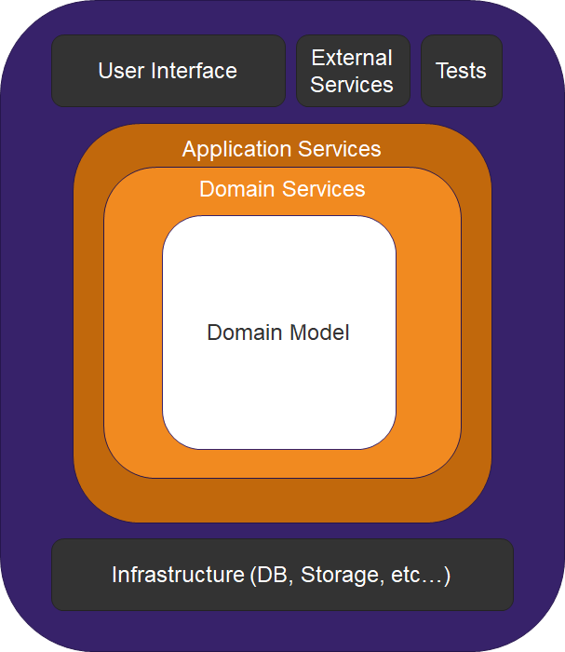
Onion Architecture
/
Clean Architecture
Notes:
Domain goes in the center. Other concerns are outside of the app.
This architecture is known by many names...
The basic concept is that the core of the app is the domain services and everything else is injected into the app.

Slide 52
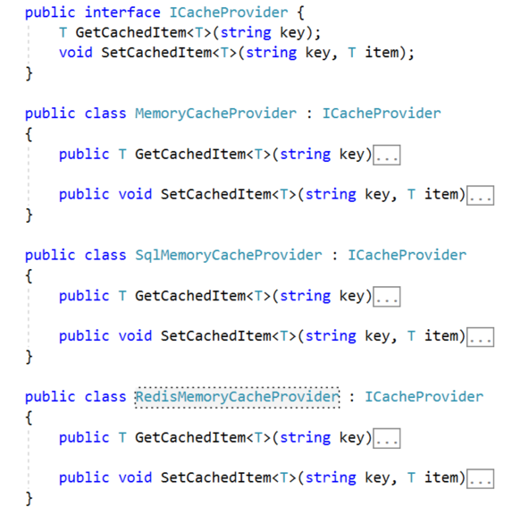
Example:
Caching
Notes:
Let’s be a little more specific here…
Caching is a good example of an external concern that you’re likely to change
Small apps can often get away with memory caching, but that falls down once you start to scale.

Slide 53
Questions/Discussion?
Notes:
Discussion Questions:
What’s the worst case of golden hammer/google envy you’ve ever seen?

Slide 54
Modern Software Architecture
Part 2: Architectural Patterns

Slide 55
Example: Lunch Ordering App
Notes:
This is an example app we can use to talk about different architectural patterns.
Pretend we’re tasked with re-writing the application that’s used to order lunch at CUNA.

Slide 56
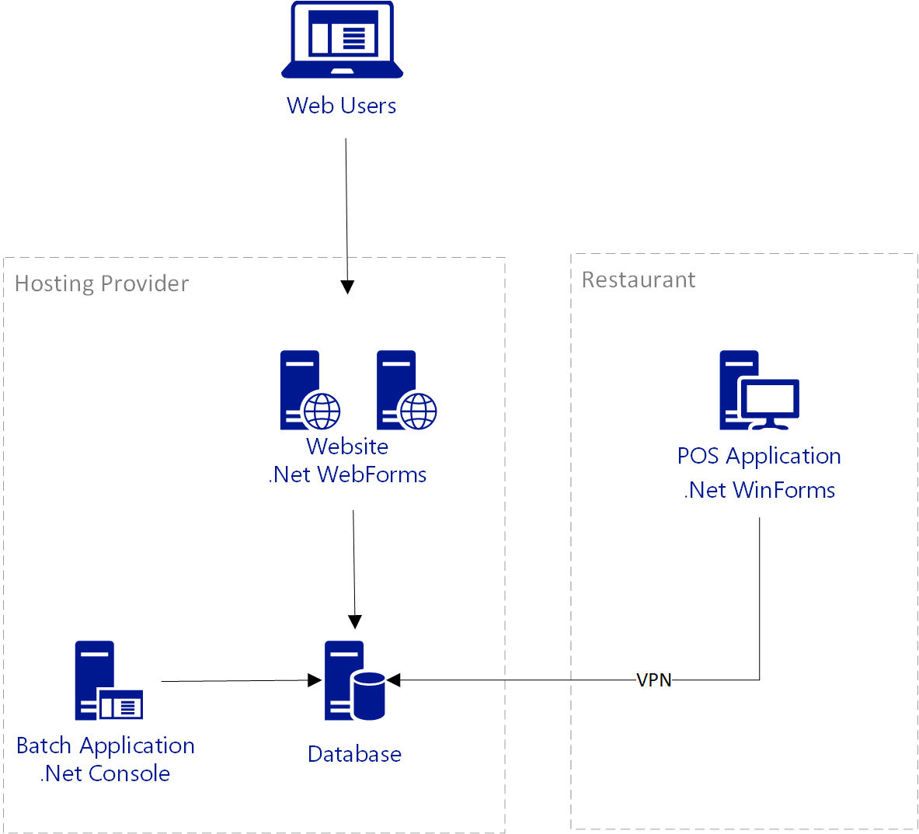
Application
Components

Slide 57
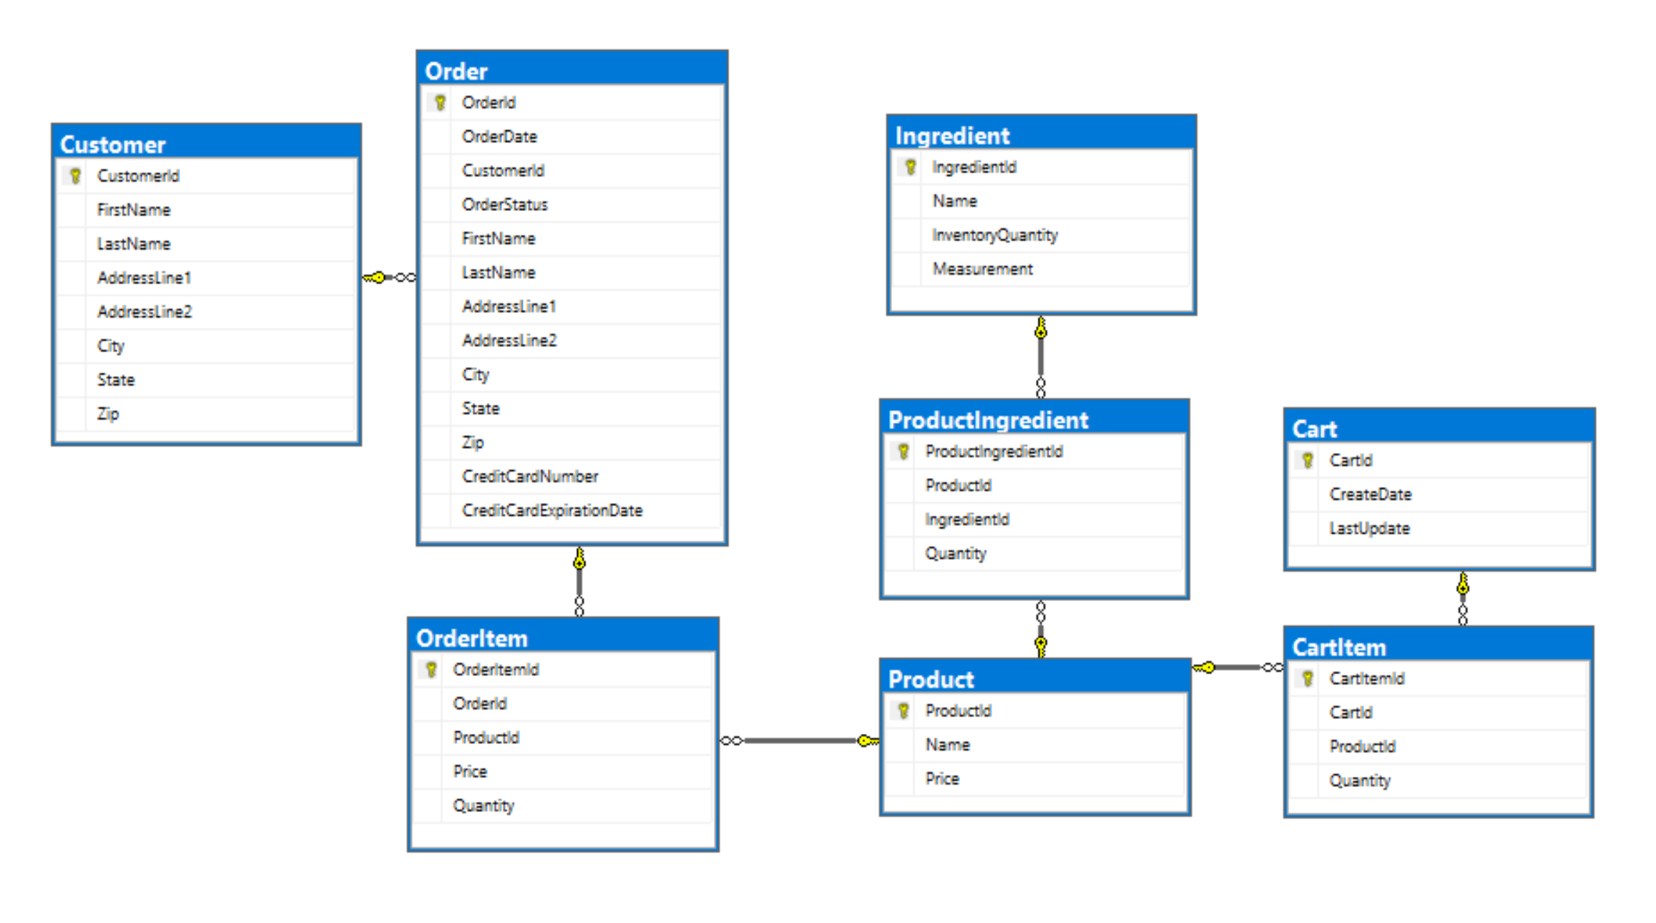
Data Model

Slide 58
Workflows
Web
View menu
Add items to cart
Check out
Desktop
Add/edit products
Process orders
View inventory
Batch
Update inventory based on orders

Slide 59
Monolith Architecture

Slide 60
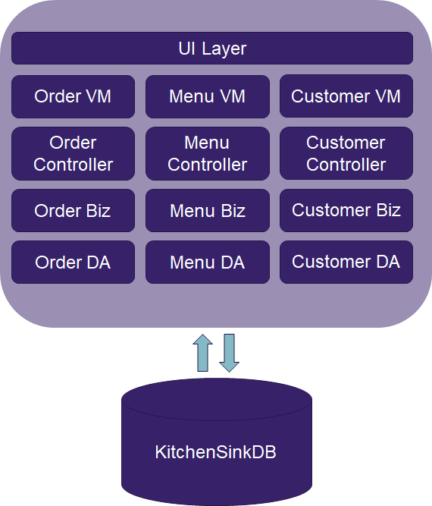
Monoliths Defined
Notes:
The default style
One giant application
Can be split into multiple layers, but it’s always horizontal slices.
Doesn’t have to be a big ball of mud, ideally it’s still a well factored application.

Slide 61
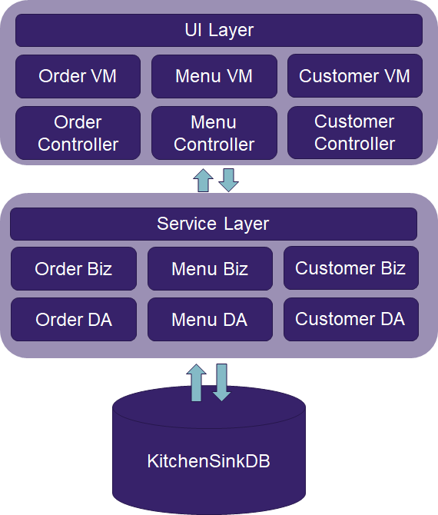
N-Tier Architecture
Notes:
Still a monolith, even if there’s somewhat independent layers
N-tier is horizontally sliced, we’ll come back to that later...

Slide 62
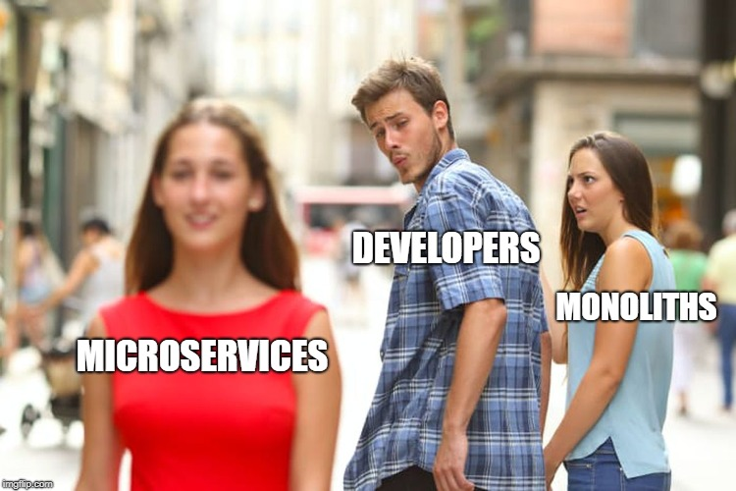
Monolith Hate
Notes:
People hate monoliths, but they’re really not that bad
It’s just that Microservices are the new hot sauce.
Remember golden hammer / cargo cult architecture / etc…

Slide 63
Monolith Advantages
Easy to start
Easy to Deploy
Easy to Provision For
Easy to Refactor

Slide 64
Monolith Disadvantages
Hard to Scale
Hard to Understand
Slower Onboarding
Hard to Upgrade
Potential Duplication
Notes:
It all comes down to scale…
As your application becomes larger, it becomes increasingly difficult to keep track of everything.
It becomes increasingly hard to maintain and upgrade your app.
It’s also harder to onboard new developers.
Hard to Upgrade;
into a new architecture
or into a new programming paradigm
Potential Duplication:
you can end up writing the same code to access the same data in different applications.

Slide 65
It’s all about the size of your app
Notes:
The pain of running a monolith is largely based on the size of your application.
Pain scales upward with application scope.

Slide 66
How to Do it Right
Separate Concerns
Maintain Soft Domain Boundaries
Practice SOLID
Build using cloud native principles
Notes:
Separate Concerns - keep your concerns separate
Maintain Soft Domain Boundaries - so if you want to refactor to services later, you can do so easily
Practice SOLID - and other good design principles

Slide 67
Microservices Architecture

Slide 68
Microservices: Defined
Domain Constricted
Vertical Services
Own Their Own Data
Accessed via Service Calls
Notes:
There are lots of differing definitions of the term Microservices, but this is what we’re going with.
Domain Constricted - MS are contained to a specific scope and domain
Vertical Services
services encompass the whole stack, all the way to the database
Owns Their Own Data - Separate databases for separate services
No cheating by backdooring into another services data
Accessed via Service Calls

Slide 69
Scope
Nano
Micro
Mini
…
WHO CARES?
Notes:
Size is irrelevant, as long as it’s vertical scope.

Slide 70
Discussion: What would our lunch app look like as a set of Microservices?

Slide 71
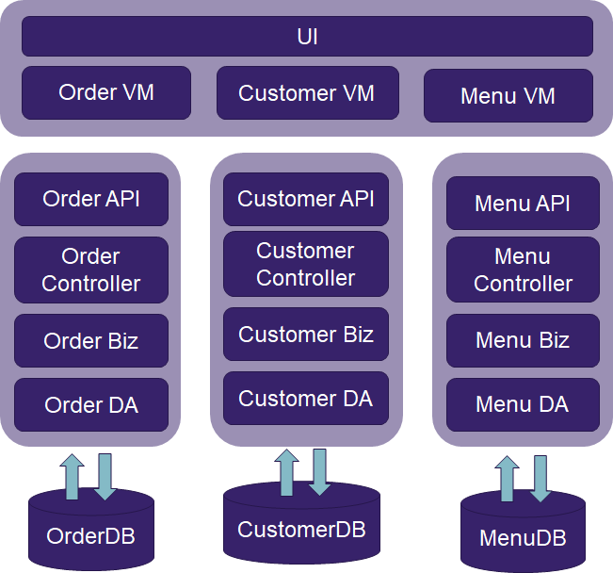

Slide 72
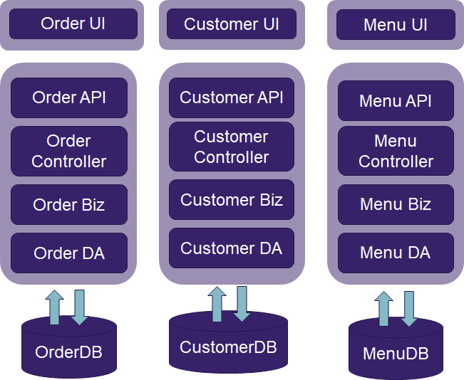
Notes:
An offshoot of this is to even use microfrontends as well as microservices

Slide 73
Microservice Advantages
Easy to Understand
Easy to Scale
Easy to Upgrade
Platform Independence
Easier to allocate work
Notes:
Easy to Understand
it’s really easy to get ramped up on Microservices
It’s also easy to reason about each individual service
Easy to Scale - You can selectively scale parts of your application
Easy to Upgrade - Smaller services are easy to upgrade
Platform Independence
You can use different technologies for each individual service.
You can cater the tech stack to the needs of the service
Work Allocation
You can put an individual team in charge of a service, instead of trying to spread work across a bunch of teams that need to coordinate with each-other

Slide 74
Microservice Disadvantages
Hard to understand (if you have too many)
Harder to Diagnose Issues
Latency
Infrastructure Drama
Cross Domain Refactoring
Notes:
Hard to understand
complex things are still complicated
Lots of services are hard to understand
Hard to reason about the whole app
Harder to Diagnose Issues - tons of interrelated services can make it hard to pinpoint problems
Latency - lots of services calling services means you need to wait for each one. also factor in costs from serialization / deserialization
Infrastructure Drama
If it’s hard to provision infrastructure, MS is going to make it way worse
lots of services are hard to deploy in sync. You also end up with different service versioning issues
Cross Domain Refactoring
Refactoring is painful when it’s across multiple services

Slide 75
Keys to Success
Strong CI/CD Practices
Scope vertically, not horizontally
Build a starter kit
Service Documentation
Service Discovery
Notes:
Strong CI/CD Practices
strong devops practices are a must have for MicroServices.
Scope vertically, not horizontally
Don’t encapsulate layers into different services. Put one domain into its own service and create thin vertical slices of functionality.
Build a starter kit
Build a starting kit for spinning up new services with your preferred company boilerplate.
Make use of package managers like NPM and NuGet to manage cross cutting dependencies
Documentation
make sure everything has relevant docs
Service Discovery
Make use of a service catalog or application gateway to keep track of all these services

Slide 76
Monoliths vs. Microservices
When to use each type of architecture

Slide 77
Where Monoliths Shine
Small to Medium Applications
New Applications
Orgs with immature CI / CD practices

Slide 78
Where Microservices Shine
Large scale applications
High Traffic Applications
Orgs with mature CI/CD

Slide 79
Consider starting with a monolith
Notes:
Martin Fowler
Many times, when you go straight to microservices, you end up failing.
Domains are often fuzzy, especially at first.

Slide 80
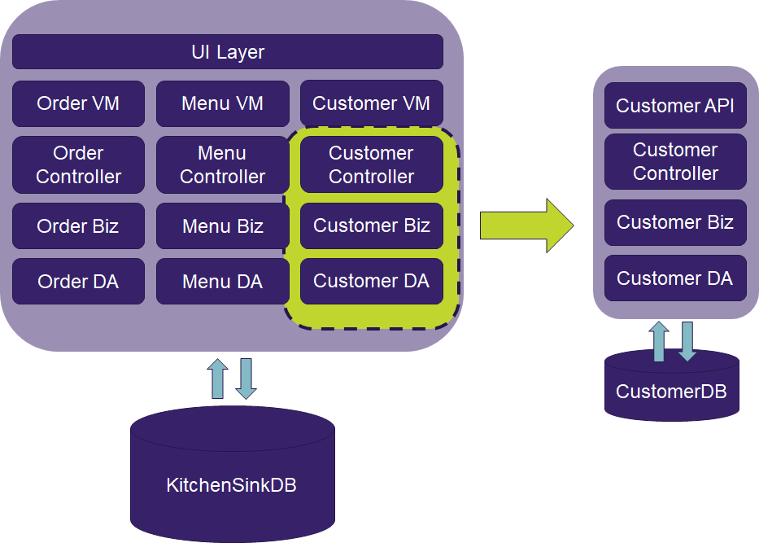
As complexity increases,
peel off services.
Notes:
Start with a monolith and peel off microservices as it makes sense.
Evolve your application over time.
This doesn’t mean avoid doing the upgrades forever, it means splitting them off incrementally.

Slide 81
Eventually…
Notes:
Eventually you’ll have services

Slide 82
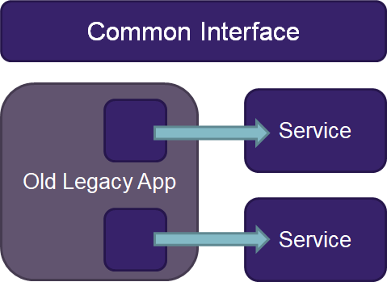
Your Legacy App is a Monolith
Notes:
If you have a giant out of date app, you already have a Monolith and can upgrade incrementally using microservices
Just keep biting chunks out of the old monolith.
Rearchitecting into microservices

Slide 83
Discussion
Monoliths and Microservices
Notes:
Questions to prompt discussion:
Who has a monolith they want to break up?
Is it worth breaking down an existing app vs. rewriting it?
Where does the golden hammer/premature scaling come into play here?

Slide 84
DISTRIBUTED MESSAGING
Modern Software Architecture
Notes:
Transition to Steve
We've talked about how to structure your system
Smaller components that are isolated into processes
Now that we have these, how do we communicate between systems?
With a monolith it was easy

Slide 85
FALLACIES OF DISTRIBUTED COMPUTING
The network is reliable
Latency is zero
Bandwidth is infinite
The network is secure
Topology doesn’t change
There is one administrator
Transport cost is zero
The network homogeneous
Notes:
Back in the 90s architects at Sun Microsystem, primarily Peter Deutsch, enumerated bad assumptions that devs make when creating distributed applications
These may seem obvious, maybe we have matured as developers, but there is still a lot of decisions we make in our systems that boil down to - this service call better be working and it better be fast
I won't go over all of these, there are some that are related to network topology and security too
What we’ll focus on is reliability

Slide 86
How do we compensate for unreliable network or service?

Slide 87
Retry
Maybe it’s just a blip
Many faults are transient and may self-correct after a short delay
Notes:
A lot of errors, especially in the cloud, are just a blip as a resource is taken down and replaced
Keep in mind that adding a retry doesn’t automatically make something more reliable, it can make it worse
Can use more complicated mechanisms like exponential backoffs
But this can result in very slow response times on retries

Slide 88
Cache
You’ve asked for that before
Cache-Aside, Read/Write-through, Refresh-Ahead, Near Cache…
“There are only two hard things in Computer Science: cache invalidation and naming things.” - Phil Karlton

Slide 89
Circuit Breaker
Stop doing it if it hurts / Give that system a break
When a system is struggling, failing fast is better than making users wait Protecting a faulting system from overload can help it recover

Slide 90
Bulkhead Isolation
One fault shouldn't sink the whole ship
When a process faults, multiple failing calls backing up can easily swamp resources on a host
Notes:
Constrains the governed actions to a fixed-size resource pool, isolating their potential to affect others.
When a process faults, multiple failing calls backing up can easily swamp resource (eg threads/CPU) in a host.
A faulting downstream system can also cause 'backed-up' failing calls upstream.
Both risk a faulting process bringing down a wider system.

Slide 91
Fallback
Degrade gracefully
Things will still fail - plan what you will do when that happens.

Slide 92



MESSAGING & RESILIENCY
Resiliency policies must be designed based on the usage pattern and business requirements
Policies are not free, they all come with a cost
Policies should be composed to meet your resiliency requirements.
Notes:
There is no global resiliency pattern that you can just apply to all service calls
example caching & eviction
Not free - don’t just put retry on everything thinking it will help

Slide 93
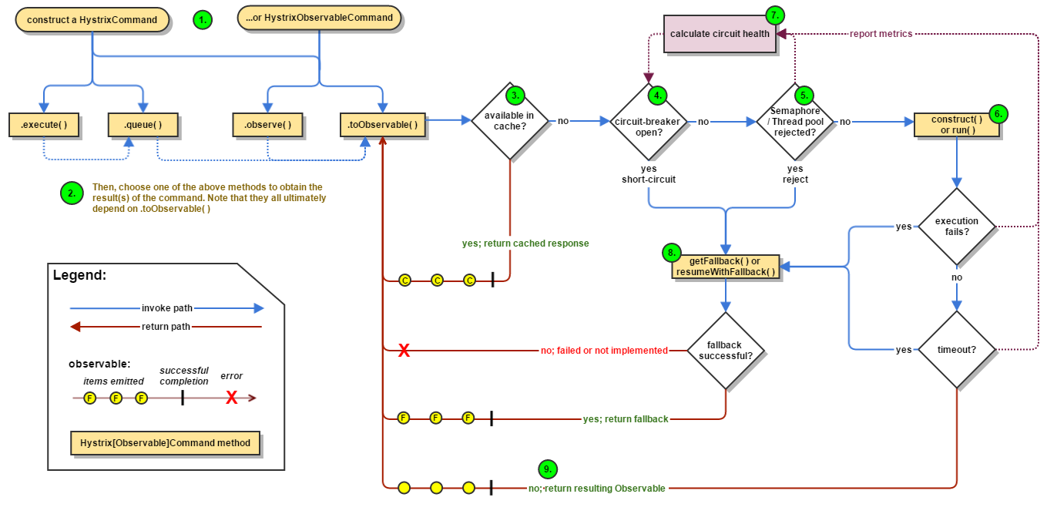
Resiliency isn’t simple...
Notes:
Hystrix pattern from Netflix

Slide 94
DEMO: MESSAGING RESILIENCY
Notes:
Service -> Data store
Retry
What if service is timing out?
Add Cache-aside
What if cache is down?
Swallow errors
What if cache is timing out?
When do we evict?
Circuit breaker
When do we trip?
Count of errors
What if we just get a burst of traffic - say X concurrent calls - does that mean that one bad client can cause a trip?
How do we bring it back up?
What do we do when the circuit is tripped (don’t have another source of data here…)
Fallback
To what?

Slide 95
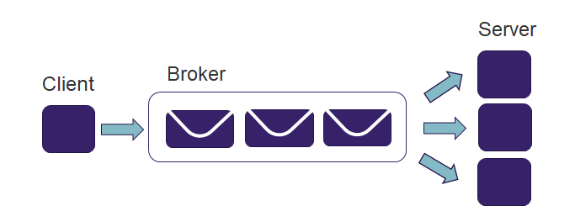
Message Queueing
Notes:
Put some storage between the sender and receiver
The call then simply verifies that the message has been written to storage
Mostly useful if the client doesn’t need a response from the server

Slide 96
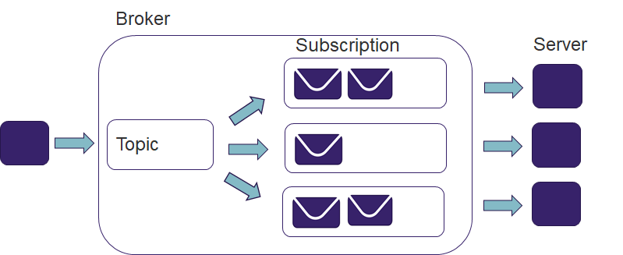
Message Brokers - Pub/Sub
Notes:
Most brokers also support publish/subscribe

Slide 97
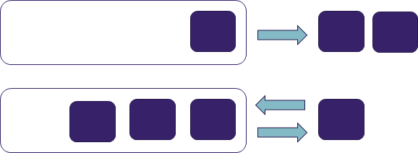
Push vs Pull
Push/Pull
Short/Long polling
Custom protocols (AMQP, MQTT, MSMQ)
Push/Push
Web hooks
Preferred 3rd party integration method
Notes:
Relates to how the message is delivered / who initiates the process
Security
Push mechanisms need to know how to securely call the service
Pull mechanisms can work behind firewalls

Slide 98
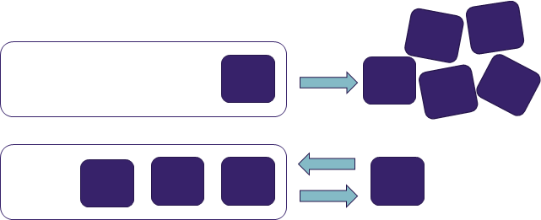
Push vs Pull
Notes:
With a push delivery all it can do is try to call the subscriber
If it can’t keep up with the producer then it just fails
Conveyor belt - say loading packages into a truck
Always on - but maybe with a stop button
vs take one as you can load them
Other nice part about pull mechanisms - built in fan-out
So why are webhooks the preferred way to do external integrations?
Part of it is just that HTTP is the standard for internet SAAS solutions - works through firewalls, well understood etc
Do you want to tell your customer’s to
What if your service has an outage? Wouldn’t you rather have the connection initiated on your timeline?
Downside: have to implement retry logic

Slide 99
Why Message Queueing?
Load leveling
Decoupling
Client/Server
Temporal
Built in pub/sub
Automatic error/retry handling
Scaling based on queue depth
Centralized management and security

Slide 100
Why Not?
Single point of failure / bottleneck
Eventual consistency
// don't expect this to work...
DataService.SaveRecord(123);
var record = DataService.GetRecord(123);
Complex!
Notes:
Eventual consistency
You get low latency and scalability for the cost of stale data
Complex
This is a different programming model than most developers are used to

Slide 101
EVENT ORIENTED ARCHITECTURE

Slide 102
What is an event?
“A significant change in state”
“Anything that happens”
$100 deposited into a bank account
The room temperature is currently 70° F
It is the top of the hour
Notes:
$100 deposited into a bank account
This is an action that a user took within your system
Room temperature
This isn’t really an action, it’s just reporting a measurement of the state of something
An event could be, yep, your servers are up and runnin
It is the top of the hour
Here events are just acting as a clock or as a scheduler
A good way to start: you probably have batch apps that trigger at a certain time, turning these into events
What are some events that happen in your systems?

Slide 103
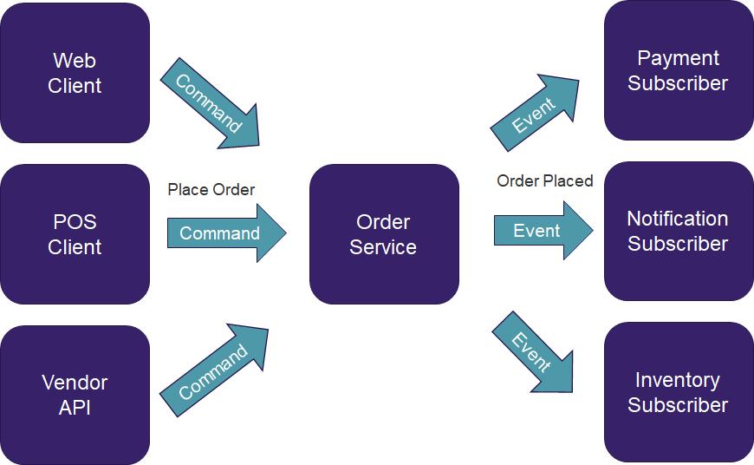
Command Messages vs Event Messages

Slide 104
What is event oriented architecture?

Slide 105
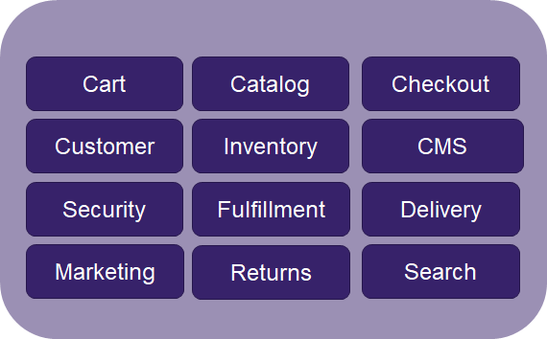
At first there was the monolith
Notes:
We’ve talkec about what an event is
what is EOA

Slide 106
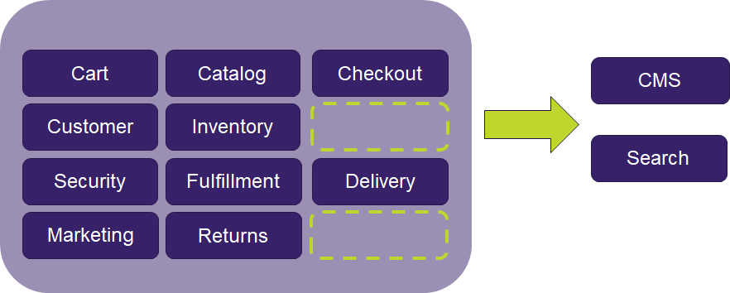
So we started down the SOA route

Slide 107

So we started down the SOA route

Slide 108
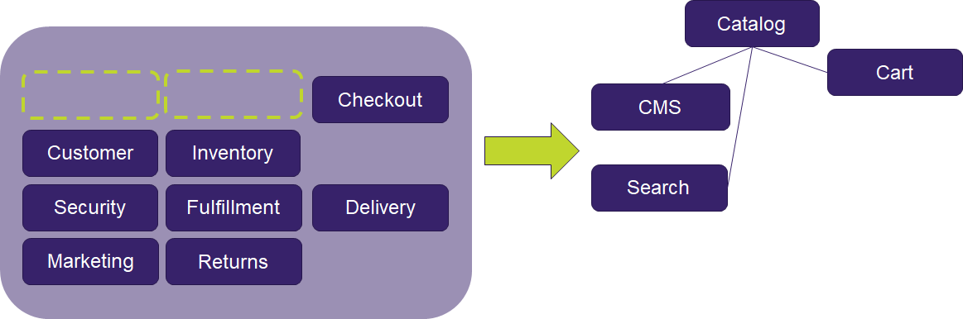
Let’s keep going… of course there are dependencies

Slide 109
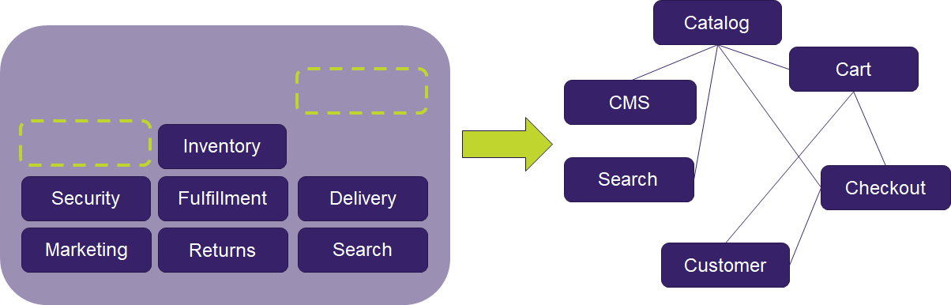
Hmmm...

Slide 110
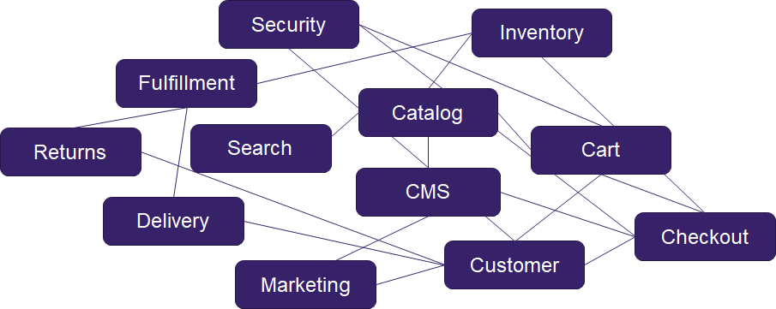
Our SOA journey is complete!

Slide 111
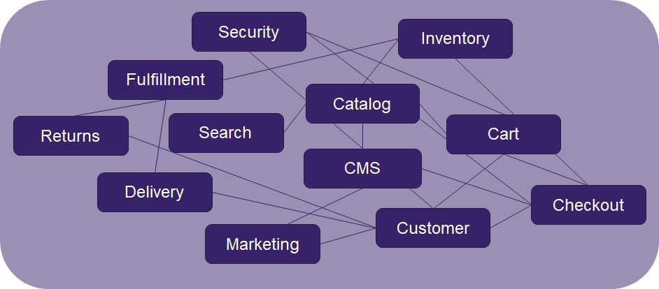
Wait a minute...
Notes:
Looks familiary
We’ve created a web of service dependenies
Some attempts to fix this include sending messages through some integration system
Maybe something that starts with a B and ends with an iztalk
It’s common to layer these
MAke data services, infrastructure services, business logic services...

Slide 112
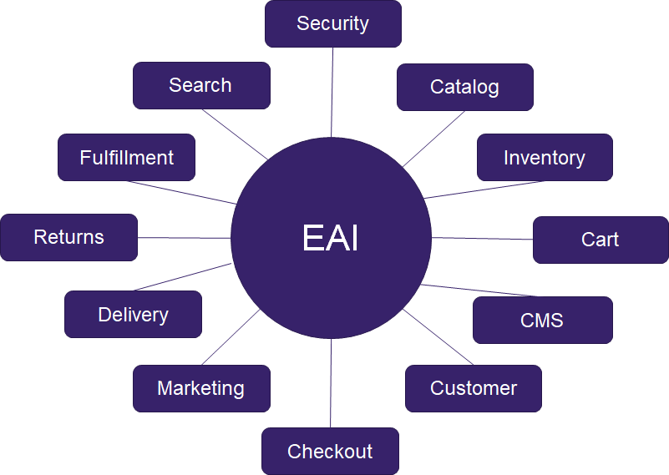
Talk to a vendor!

Slide 113
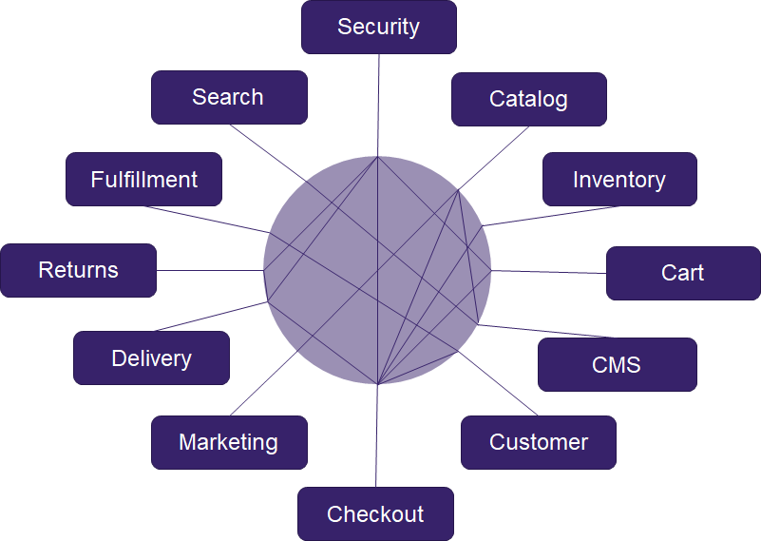
We’ve just hidden it...

Slide 114
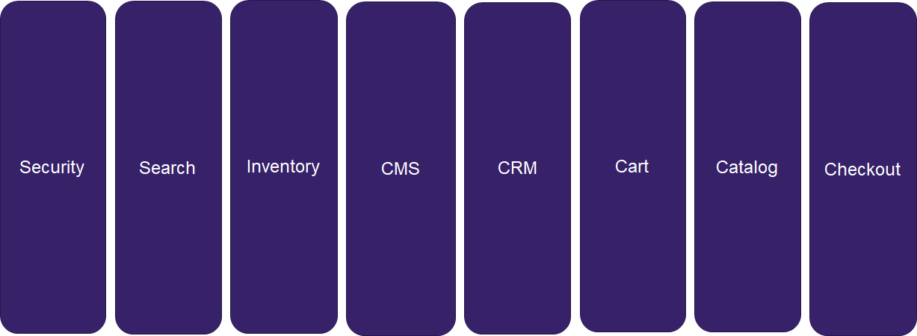
Microservices to the rescue!

Slide 115
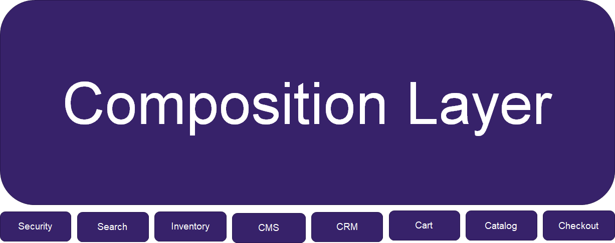
Doh.
Notes:
This can be a sign the domains are not correct
But even a good design can have this happen
A response can be to create composition services on top of these services, but now you’re just going down the tiered SOA route
So what do we do? Let’s zoom in on a specific example

Slide 116
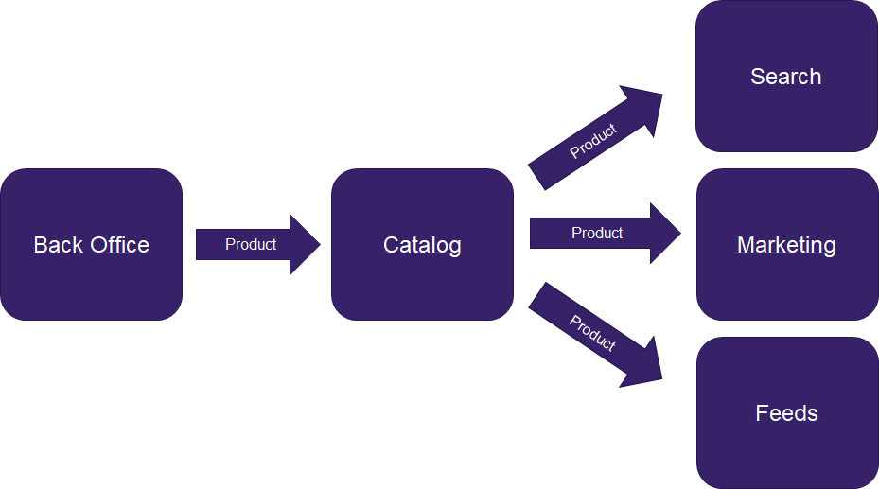
Catalog service knows too much about dependencies...
Notes:
Ok, let’s look at the flow of a specific example
So we’re architects right? what do we do?

Slide 117
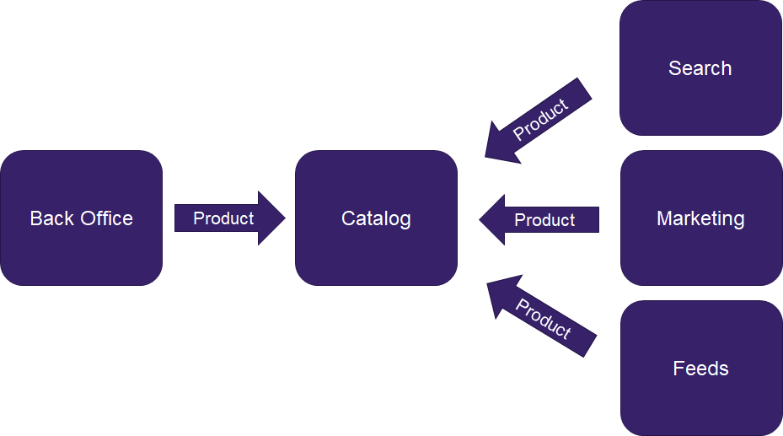
Inversion of Control!
Notes:
We change the arrows

Slide 118
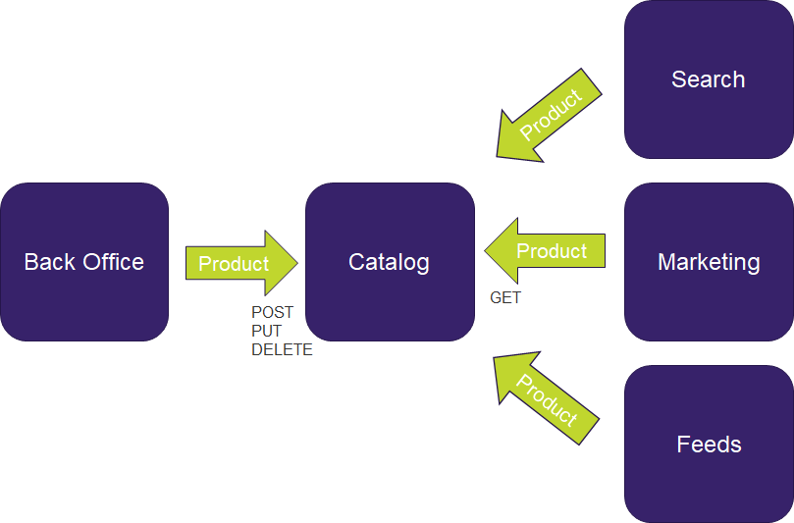
When do we call
When do we call GET?
Batch jobs?
Notes:
But when do the services call the catalog service?
Batch jobs?
File transfers? (since there could be lots of data in each batch)
Database to database ETL?

Slide 119
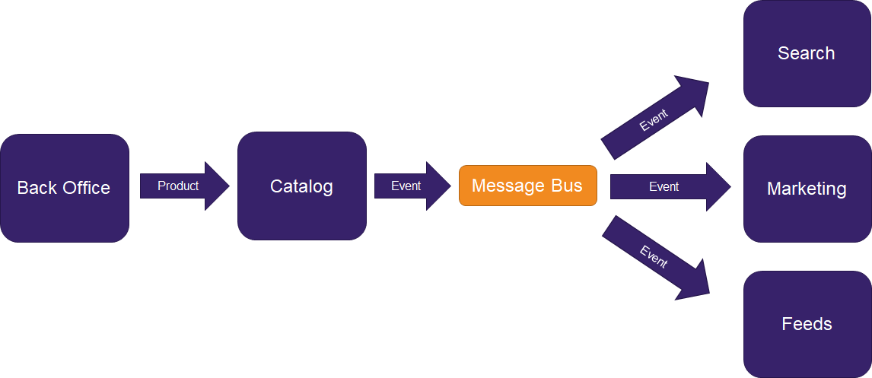
Enter events - A way to invert distributed dependencies
Notes:
Instead of calling services directly we raise events to a bus
Catalog does not know about the downstream systems
Downstream services are not dependent on catalog service - only event contracts
Outages do not take down dependent systems
Downstream systems receive events in real time

Slide 120
WHEN TO USE EVENTS?
Remove dependencies on unrelated systems
Share state changes with other teams
Transfer data deltas in real time
Coordinate long running or interactive workflows
Listen for: “When X happens then Y”
“When an order is placed…”
“When a policy is issued…”
But, not everything: “When a user logs in they see the dashboard”
Notes:
This isn’t a golden hammer
Question: What events do you guys have in your systems?

Slide 121
EVENT STREAMING
AKA “Big data in motion”
When streaming?
Time series data
Events that aren’t valuable on their own, only in aggregate
e.g. IOT, Telemetry
Not for events with identity or rich data
Notes:
TODOs:
- An IOT sensor measurement (e.g. a temperature measurement, a mouse click) isn't rich,
doesn't have identity,
- isn't valuable on it's own, only in aggregate with other related events
- A credit card payment does

Slide 122
WHERE DO I START?
Identify data that is a history of events
You’re already doing this!
Start raising important events
It’s decoupled, doesn’t matter if there are no subscribers
Identify batch processes that could be real-time
Or just kick off your batch processes using a time event
Notes:
TODOs:
- An IOT sensor measurement (e.g. a temperature measurement, a mouse click) isn't rich,
doesn't have identity,
- isn't valuable on it's own, only in aggregate with other related events
- A credit card payment does

Slide 123
SAGAS

Slide 124
SAGAS
“Sagas”, “Workflows”, “Orchestrations”
Stateful processing of events
Long running workflows (e.g. manual approvals)
Processes based on receiving multiple events in any order (e.g. “Once X, Y, and Z happen then…”)
Fan-in scenarios
A way to implement distributed transactions

Slide 125
SAGA Orchestration Tools
EAI products - BizTalk
Libraries - NServiceBus, WCF Workflow Foundation
Workflow PAAS - Azure Logic Apps, Azure Stateful Functions
Code - Services + Databases

Slide 126
EXERCISE: DESIGN AN EVENT FLOW
Notes:
Service -> Data store
Retry
What if service is timing out?
Add Cache-aside
What if cache is down?
Swallow errors
What if cache is timing out?
When do we evict?
Circuit breaker
When do we trip?
Count of errors
What if we just get a burst of traffic - say X concurrent calls - does that mean that one bad client can cause a trip?
How do we bring it back up?
What do we do when the circuit is tripped (don’t have another source of data here…)
Fallback
To what?

Slide 127
Exercise
When someone orders lunch:
Charge their credit card
Send a notification of the order to the restaurant
Restaurant acknowledges order received
If card is charged and order is acknowledged, send email to customer that their order is in progress
Restaurant marks order as out for delivery
If it takes longer than 30 minutes refund their card

Slide 128
PITFALLS

Slide 129
TIME
Time event happened != Time event published != Time event received != Time event finished processing
Events do not necessarily come in order
Saga handlers may be running when additional events arrive

Slide 130
IDEMPOTENCY
Events may be received more than once - Handlers must be idempotent
Non-transactional services can be wrapped in command messages

Slide 131
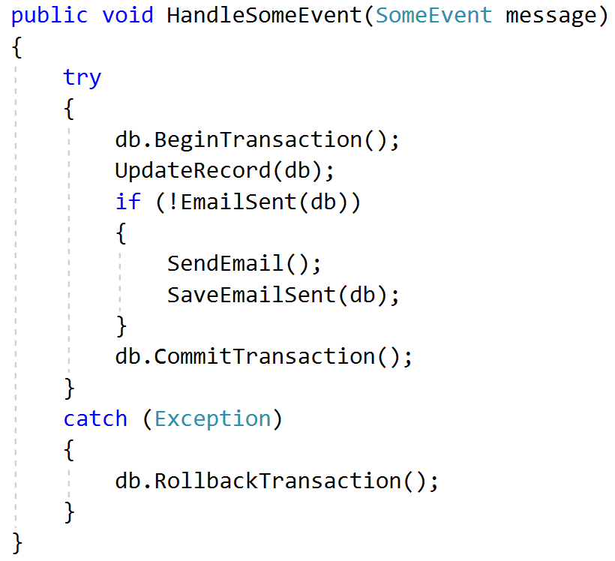
IDEMPOTENCY

Slide 132
ERROR HANDLING
Errors happen after client has continued on
Manual remediation may be required for failures
Automatic remediation will likely require rollback operations for all other actions

Slide 133
THUNDERING HERD PROBLEM
When a large number of processes are awoken by an event, but a small number are available to proceed at a time.
<customerCreatedEvent> <customerId>123</customerId> </customerCreatedEvent>

Slide 134
TRACEABILITY
Attach a unique ID to each message
Use tools that automatically trace message paths
Sagas provide great code-based documentation
Notes:
Event oriented architectures are inherently decoupled and non-linear, and thus hard to reason about

Slide 135
VERSIONING
Version must live with message
Previous versions may still be in flight when updates are released!

Slide 136
Questions?
Notes:
Service -> Data store
Retry
What if service is timing out?
Add Cache-aside
What if cache is down?
Swallow errors
What if cache is timing out?
When do we evict?
Circuit breaker
When do we trip?
Count of errors
What if we just get a burst of traffic - say X concurrent calls - does that mean that one bad client can cause a trip?
How do we bring it back up?
What do we do when the circuit is tripped (don’t have another source of data here…)
Fallback
To what?

Slide 137
Emergent Architecture
Notes:
You’re probably all thinking about going back to your desks and deleting everything you have right?
You’re going to tell the business to put in a year long change freeze and just work on architecture

Slide 138
Rome wasn’t built in a day
and neither is your software
Notes:
We need to find a way to balance the needs of today with future architectural decisions.
and we need to get there in small increments - we’re agile!
Architecture seems to be in conflict with agile - isn’t it all about design up front?

Slide 139
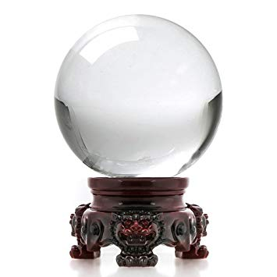
Change is inevitable
Technology will change
The Domain will change
Optimize your architecture for change
Notes:
It depends on what you’re designing for
Technology - Languages, Libraries, Frameworks, Tools
Domain - Products, Competitors, Customer needs, Markets
We can’t predict the future
but we know change is coming, we should optimize for the fact that we don't know what is coming
We optimize for other ilities
Scalability, Reliability, Availability, etc
More than anything we need to optimize for changeability

Slide 140
Remember YAGNI
Build what you need when you need it.
Wait until the “last responsible moment” to make decisions.
Notes:
BUT remember YAGNI
Avoid building things you don’t need
Make things easy to change and swap out components
Don’t do everything up front.
We’re agile now.
“Last responsible moment”: Keep important and irreversible decisions open until the cost of not making a decision becomes greater than the cost of making a decision.
Of course there is a balance - it is not always realistic to design an entire architecture for a feature and build it in a sprint

Slide 141
Make Things Easy to Change
Make your technology easy to change
Automate tests, automate releases, automate infrastructure...
Abstract dependencies
The goal is high cohesion, low coupling
Notes:
Tests
- Tests Create Safety
- If you are going to be rapidly iterating and refactoring, you need to make sure every change doesn’t affect the behavior of the system
- This is not optional if you are going to emerge your architecture
Abstracting Dependencies - Don’t make yourself dependent on a particular external concern
Group systems by business domain
The previous items make it easier to change technology, but they say nothing about the domain
If I abstract out the database, wonderful, I can change database providers
but that doesn’t help me if the business decides on a new direction for the app

Slide 142
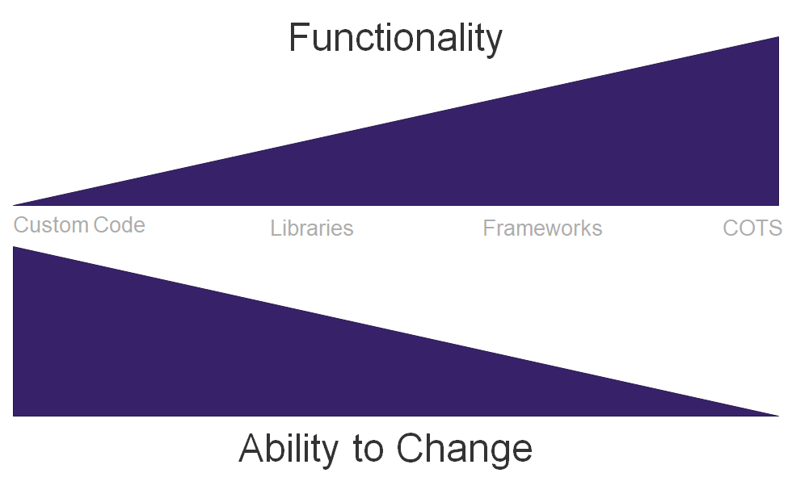
Avoid deep dependencies on tools
Notes:
Avoiding deep coupling with tools - Don’t use tools that force you to adopt their workflow

Slide 143
Make Things Easy to Change
Make your domain easy to change
Use domain driven design
Use a ubiquitous language when talking with the business
Design bounded contexts around business domains
Notes:
Tests
- Tests Create Safety
- If you are going to be rapidly iterating and refactoring, you need to make sure every change doesn’t affect the behavior of the system
- This is not optional if you are going to emerge your architecture
Abstracting Dependencies - Don’t make yourself dependent on a particular external concern
Group systems by business domain
The previous items make it easier to change technology, but they say nothing about the domain
If I abstract out the database, wonderful, I can change database providers
but that doesn’t help me if the business decides on a new direction for the app

Slide 144
How do we migrate a legacy application?
Notes:
But what if it’s not architected for change?

Slide 145
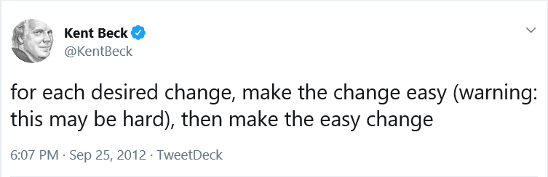
Notes:
https://twitter.com/KentBeck/status/250733358307500032?s=20
Referring to refactoring

Slide 146
How do we add tests to an untested legacy app?

Slide 147
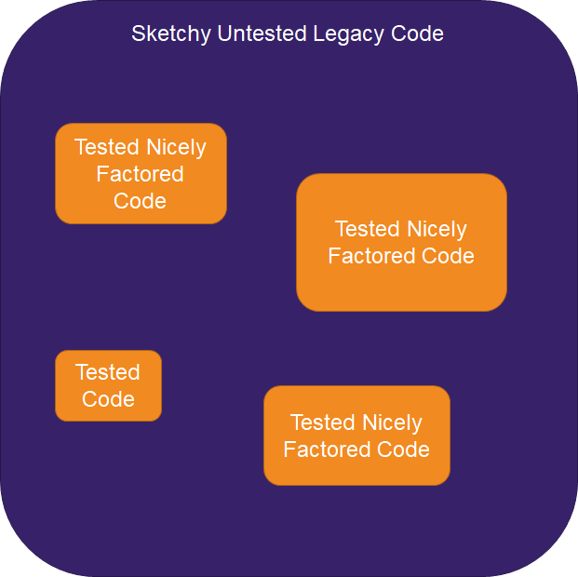
“Islands” of Testable Code
Notes:
This is a Martin Fowler refactoring pattern
As you convert a legacy app, build tests around what you change.
The upshot is that the nastiest part of the code will soon become the most tested part of the code.

Slide 148
How can we move a legacy app to a new architecture?
Notes:
Let’s say you’re re-architecting an app. How do you incrementally move it to a new pattern without having to “big bang” move everything?

Slide 149
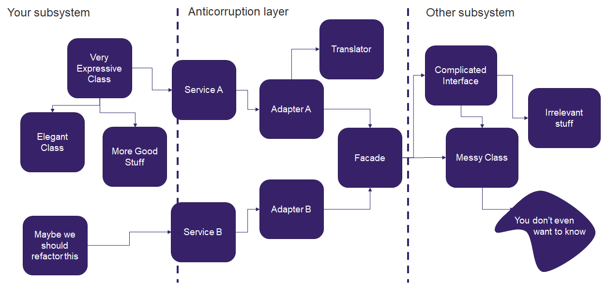
Anticorruption Layer

Slide 150
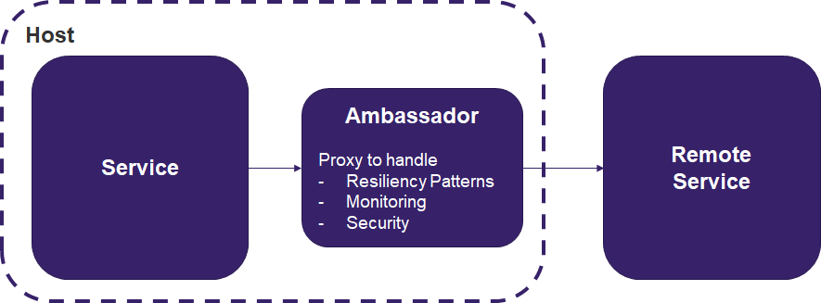
Ambassador Pattern
Notes:
Something we can do with legacy systems that we can’t touch is put these new layers or facades in a separate application

Slide 151
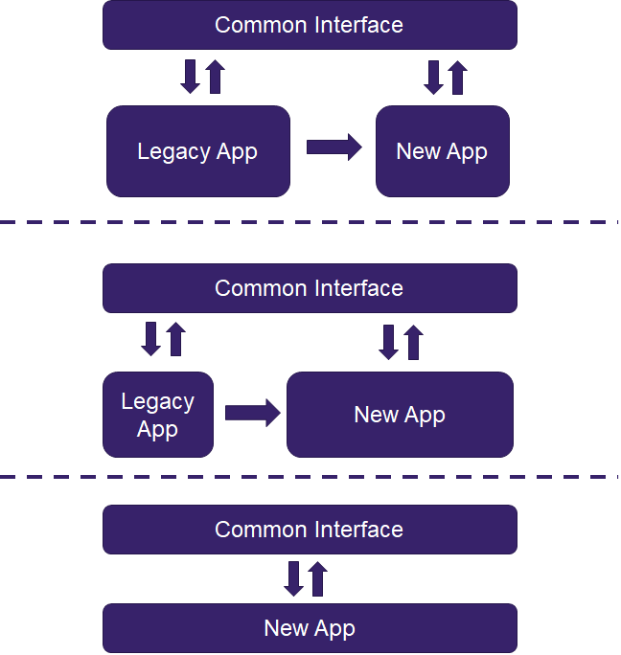
Strangler Pattern
Notes:
TODO - take another pass at this image. Microsoft has a good image for this.
----
A pattern for evolving legacy applications.
Create a facade for your application. Slowly migrate your old functionality into the new paradigm. Eventually, you’ll strangle your legacy application away.
https://docs.microsoft.com/en-us/azure/architecture/patterns/strangler
Example interface: proxy server

Slide 152
How do I go about building my service domains?

Slide 153
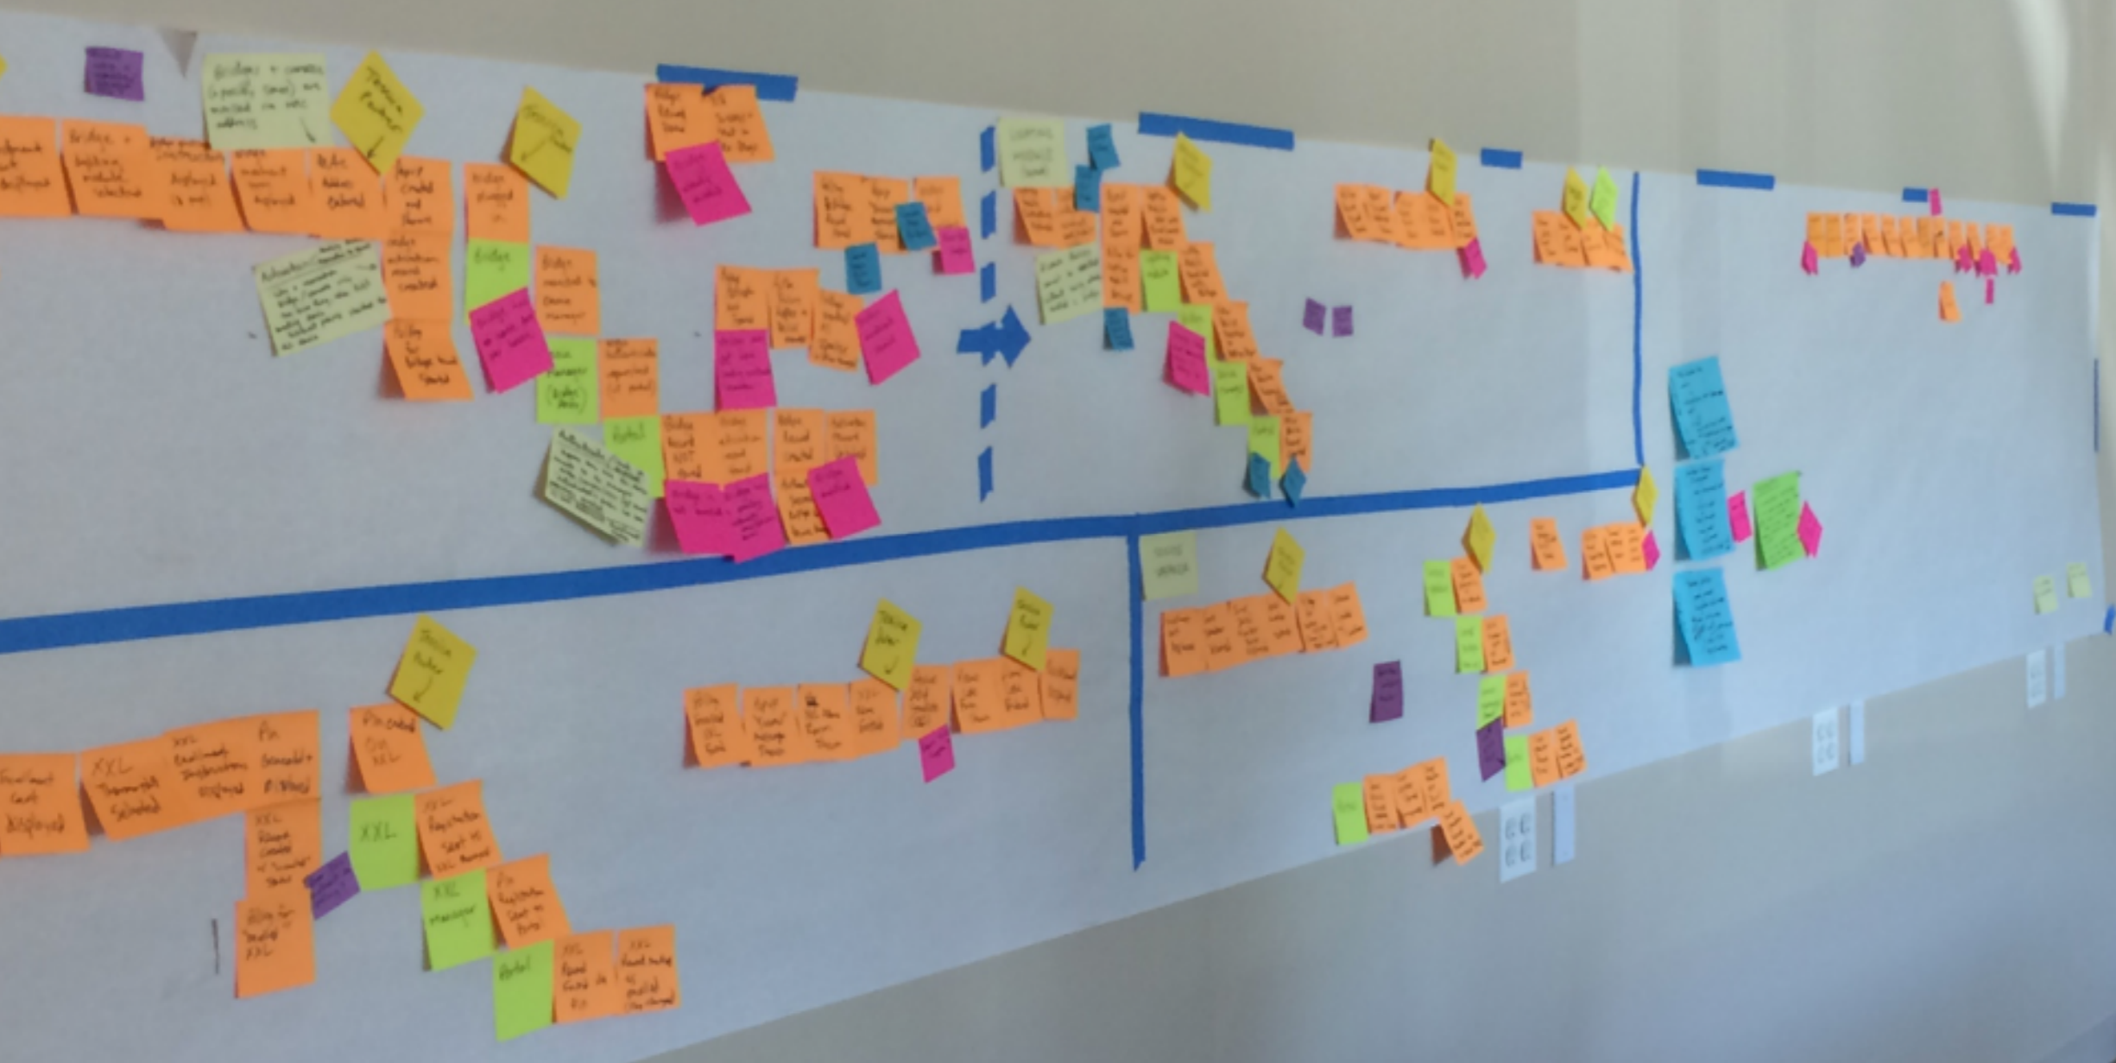
Event Storming
Notes:
Define all of the events that happen in the system
Write in past tense - "Seat Chosen", "Ticket Purchased"
Put those all up in a straight line on the board to make the happy path
Iterate on it and add non-happy paths / alternatives
Make clumps of things - bounded contexts
Notice that there are two events that connect two contexts
A lot of times there are big groups of events, then just one or two that connect the next step
This is a signal that these are transitions between systems
Add additional things
Add commands
Danger points, etc
Until you have enough information
Find a slice candidate
A slice is a series of events
Can cross aggregates or bounded contexts

Slide 154
Conway’s Law:
Organizations which design systems are constrained to produce designs which are copies of the communication structures of these organizations

Slide 155
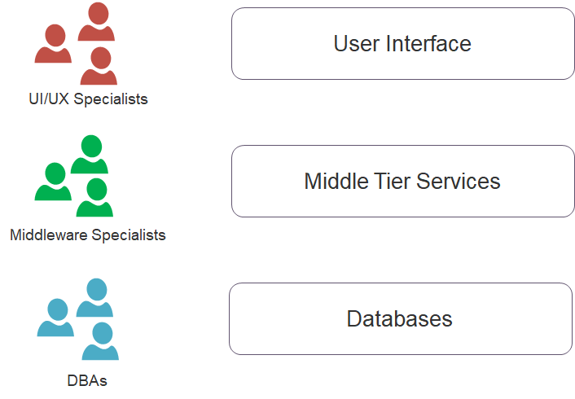
Conway’s Law

Slide 156

Conway’s Law

Slide 157
Inverse Conway Manoeuvre:
Design the organization you want, the architecture will follow (kicking and screaming)

Slide 158

Inverse Conway Manoeuvre

Slide 159

Inverse Conway Manoeuvre

Slide 160
EXAMPLE: EVOLVE A LEGACY APP
Notes:
Service -> Data store
Retry
What if service is timing out?
Add Cache-aside
What if cache is down?
Swallow errors
What if cache is timing out?
When do we evict?
Circuit breaker
When do we trip?
Count of errors
What if we just get a burst of traffic - say X concurrent calls - does that mean that one bad client can cause a trip?
How do we bring it back up?
What do we do when the circuit is tripped (don’t have another source of data here…)
Fallback
To what?

Slide 161
Testable Islands
Dependency Injection / Inversion of Control
Platforms not Programs
Emergent Architecture
Anti-corruption Layer
Strangler Pattern
Automated Testing (UI, Integration, Unit)
Onion/Clean Architecture
Notes:
Walk through the lunch ordering app and migrate a service

Slide 162
Questions / Discussion/ Parking Lot?
Notes:
Discussion Questions:
What’s the worst case of golden hammer/google envy you’ve ever seen?

Slide 165

Synchronous Messaging
Why?
Easy to understand
Easy to implement
Lots of tools and frameworks
Immediate error feedback
Why Not?
Scalability
Coupling
Long running processes
Reliability
Notes:
The standard way we are all used to is synchronous message calls
Scalability - connections are a finite resource
also, chaining together calls can lead to significant performance problems
Coupling
to share data the client needs to know about all systems it’s connected to and how to call them
Reliability
The service has to be up, and it has to succeed while we’re waiting
especially if you are chaining service calls together
Availability: SLA should be for the entire system

Slide 166

Asynchronous
Why?
Responsiveness
Scalability
Fire and forget
Long running processes
Why Not?
Complex! Threading, message correlation, error handling
Latency
Notes:
Note there is still an implied request/response
but in this case the client is just waiting for an acknowledgement that the server received the request
We are not waiting for the server to complete and send the result
We’re not talking about UDP
(although there are protocols that implement events with it)
Scalability
a different client may handle the response
Long running
I drew it as the server running, but it might not be

Slide 168

Example: Notifications

Slide 169

Example: Notifications
Notes:
It all comes down to scale…
As your application becomes larger, it becomes increasingly difficult to keep track of everything.
It becomes increasingly hard to maintain and upgrade your app.
It’s also harder to onboard new developers.

Slide 170

Example: Notifications
Notes:
It all comes down to scale…
As your application becomes larger, it becomes increasingly difficult to keep track of everything.
It becomes increasingly hard to maintain and upgrade your app.
It’s also harder to onboard new developers.

Slide 172
Technology Drivers
System decoupling
Extensibility
Resiliency
Centralized security and administration
Business Drivers
Continuous situation awareness
Real-time decision making
Improved user experience
Rapid reduced risk innovation

Slide 173
Event Notification
Event-Carried State Transfer
Event Sourcing
Event Streaming
Notes:
TODOs:
- Definitions of all

Slide 174
A system sends event messages to notify other systems of a change in its domain
Source system doesn’t care about the response
Usually coupled with a publish/subscribe to allow self service of events
Consumers may have to reach back to publisher to augment the message data
Notes:
This is the one you are probably familiar with

Slide 175
Data changes are broadcast to other systems so they can store their own copy of the data
Event contains all data. Consumers don’t need to reach out to source system.
Think database log shipping
Notes:
TODOs:
- An IOT sensor measurement (e.g. a temperature measurement, a mouse click) isn't rich,
doesn't have identity,
- isn't valuable on it's own, only in aggregate with other related events
- A credit card payment does

Slide 176
Every event is recorded so the current state of the system can be rebuilt
Like a ledger
Think source control
Notes:
TODOs:
- An IOT sensor measurement (e.g. a temperature measurement, a mouse click) isn't rich,
doesn't have identity,
- isn't valuable on it's own, only in aggregate with other related events
- A credit card payment does

Slide 177
Saga Example
When a policy is issued...
A policy document must be created and stored in the document management system. (~5 min)
The policy must be manually approved in the policy administration system.
The policy must be associated with a consumer record in the data warehouse.
After 1-3 are complete the policy is set up and available online, send an email to the policy owner.
Notes:
Based on a true story
Users come in online and submit a form to apply for life insurance
That system then issues a policy
^ So right here to see a potential event
This is a significant thing, it’s likely lots of apps will be interested,
let’s not code all of the processes into the policy submission app
1-3 can all happen at once
#4 happens only once 1-3 are done
Ideally we want this to happen as quickly as possible so we don’t lose the user
If one of the slow processes is optimized we would like the process to happen quicker

Slide 179

Saga Example

Slide 180

Saga Example

